Slide 1
Physical Sciences Science
4th grade
Here is where your presentation begins

Slide 2
Contents of this template
You can delete this slide when you’re done editing the presentation
Fonts | To view this template correctly in PowerPoint, download and install the fonts we used
Used and alternative resources | An assortment of graphic resources that are suitable for use in this presentation
Thanks slide | You must keep it so that proper credits for our design are given
Colors | All the colors used in this presentation
Icons and infographic resources | These can be used in the template, and their size and color can be edited
Editable presentation theme | You can edit the master slides easily. For more info, click here
For more info:
SLIDESGO | BLOG | FAQs
You can visit our sister projects:
FREEPIK | FLATICON | STORYSET | WEPIK | VIDEVO

Slide 3
Table of contents
01
02
03
04
Matter magic
Electric energy
You can describe the topic of the section here
You can describe the topic of the section here
Force fun
Magnet wonders
You can describe the topic of the section here
You can describe the topic of the section here

Slide 4
Whoa!
This can be the part of the presentation where you introduce yourself, write your email…

Slide 5
01
Matter magic
You can enter a subtitle here if you need it

Slide 6
You should know
Mercury is the closest planet to the Sun and the smallest one in the entire Solar System. Contrary to popular belief, this planet's name has nothing to do with the liquid metal. Mercury was, instead, named after the famous Roman messenger god Mercurius
Mercury takes a little more than 58 days to complete its rotation, so try to imagine how long days must be there! Since the temperatures are so extreme, albeit not as extreme as on Venus, Mercury has been deemed to be non-habitable for humans

Slide 7
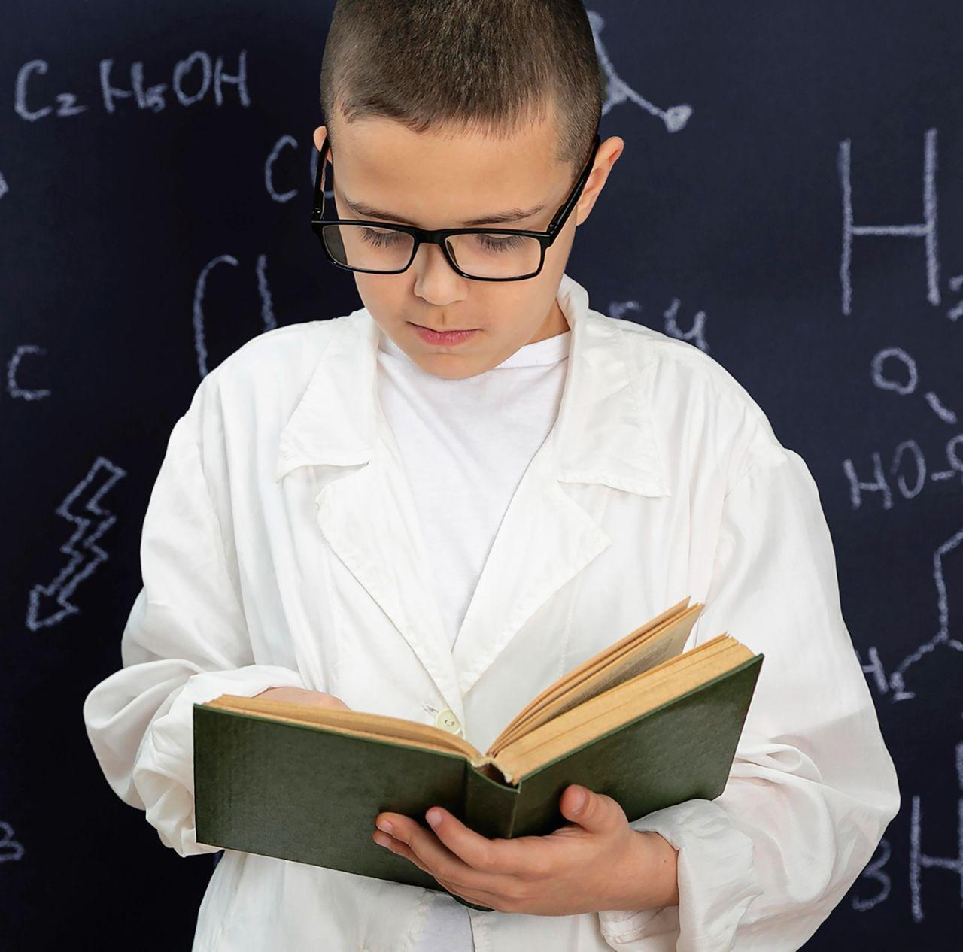
Get these items to begin
Do you know what helps you make your point crystal clear? Lists like this one:
They’re simple
You can organize your ideas clearly
You’ll never forget to buy milk!
And the most important thing: the audience won’t miss the point of your presentation

Slide 8
What will we learn?
History
Tests
Mercury is the closest planet to the Sun and the smallest one in the Solar System—it’s only a bit larger than the Moon
Venus has a beautiful name and is the second planet from the Sun. It’s hot and has a poisonous atmosphere

Slide 9
About science investigation
Hypothesis
Observation
Replication
Despite being red, Mars is actually a cold place. It’s full of iron oxide dust
Venus has a beautiful name and is the second planet from the Sun
Mercury is the closest planet to the Sun and the smallest of them all

Slide 10
Key concepts we will use
Motion
Gravity
Relativity
Reaction
Earth is the place where we live on
Despite being red, Mars is a cold place
Jupiter is the biggest planet of them all
Saturn is a gas giant and has several rings

Slide 11
Important related notions
Energy
Matter
Mars is actually a very cold place
Venus has a beautiful name
Force
Kinematics
Neptune is far away from us
Mercury is a very small planet
Reactions
Astrophysics
Saturn is a gas giant with several rings
Earth is the place where we live on

Slide 12
Awesome words

Slide 13
“This is a quote, words full of wisdom that someone important said and can make the reader get inspired”
—Someone Famous

Slide 14
A picture always reinforces
the concept
Images reveal large amounts of data, so remember: use an image instead of a long text. Your audience will appreciate it

Slide 15
Success level per course
25%
30%
45%
Group A
Mercury is the closest planet to the Sun and the smallest of them all
Group B
Venus has a beautiful name and is the second planet from the Sun
Group C
Despite being red, Mars is actually a cold place. It’s full of iron oxide dust

Slide 16
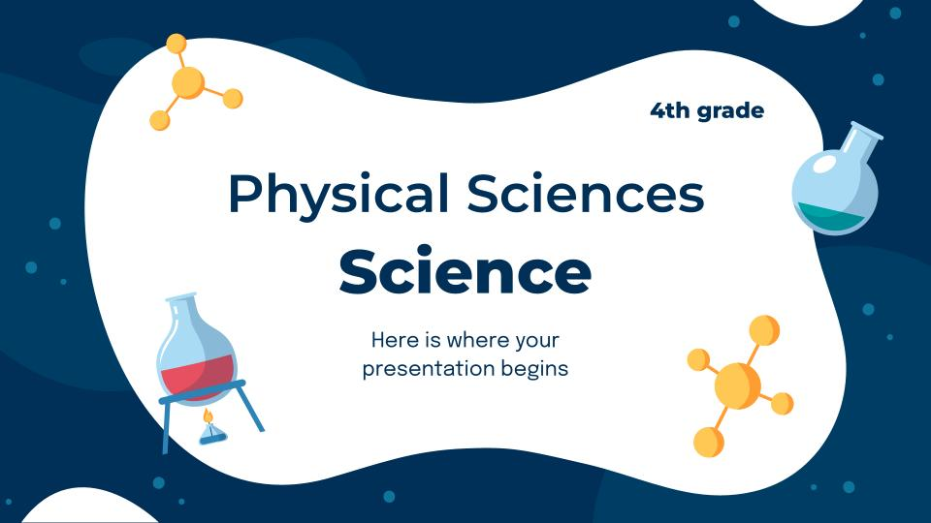
Computer mockup
You can replace the image on the screen with your own work. Just right-click on it and select “Replace image”

Slide 17
Tablet mockup
You can replace the image on the screen with your own work. Just right-click on it and select “Replace image”

Slide 18
Phone mockup
You can replace the image on the screen with your own work. Just right-click on it and select “Replace image”

Slide 19
Places we teach
Region 1
Venus is the second planet from the Sun
Region 2
Mercury is the closest planet to the Sun
Region 3
Despite being red, Mars is a very cold place

Slide 20
Our next activities
Tuesday
Thursday
Venus is the second planet from the Sun
Mars is actually a very cold place
Monday
Wednesday
Friday
Jupiter is the biggest planet of them all
Saturn is the only planet with rings
Earth is the place where we live on

Slide 21
Brief topic description
Feature A
Feature D
Mars is a red planet
Venus is a hot planet
Feature B
Physics sciences
Feature E
Mercury is very small
Jupiter is a gas giant
Feature C
Feature F
Earth is our home
Saturn has rings

Slide 22
Let's give some examples
 | Group 1 | Group 2 | Group 3
Example A | Saturn | Jupiter | Mercury
Example B | Earth | Venus | Mars
Example C | Moon | Pluto | Ceres

Slide 23
Activity 1 - Giving details
Write the name of each element and give a brief description of its use:
Lamp
?
?
?
It serves to illuminate our house at night
Try to describe what this element is for
Try to describe what this element is for
Try to describe what this element is for

Slide 24
Activity 2 - Try to recognize them
Read the following words and color the ones that are related to physical science:
Chemistry
Sports
Money
Art
Geology
Biology
Astronomy
People
Physics
Atomic
Mathematics
Literature

Slide 25
Activity 3 - Matching pairs
Try to match each word with its corresponding icon using the connectors:
Geology
Astronomy
Nuclear
Physics

Slide 26
Activity 4 - True or false?
Read each of the statements and color the option that seems best to you:
Physical sciences have no relevance to our everyday lives
T
F
Chemistry is the only branch of the entire physical sciences
T
F
Mathematics serves as a foundation for the physical sciences
T
F
Physics and chemistry are major branches of physical sciences
T
F

Slide 27
Activity 6 - What do you think?
Write some of the reasons why you think physical science is very important:
Reason 1
Physical sciences deepen our understanding of the natural world and also how it works
Reason 2
Write briefly why you think physical science is important here
Reason 3
Write briefly why you think physical science is important here
Reason 4
Write briefly why you think physical science is important here

Slide 28
Activity 7 - Final review
Taking into account what you have learned, try to give a description of each word:
Chemistry | Discipline that studies matter, its properties and composition
Geology | Insert a brief description of the word here
Biology | Insert a brief description of the word here
Physics | Insert a brief description of the word here
Astronomy | Insert a brief description of the word here

Slide 29
Thanks!
Do you have any questions?
youremail@freepik.com
+91 620 421 838
yourwebsite.com
Please keep this slide for attribution

